Slide 1
ISPR : Assignment 5
CHIARA DE NIGRIS (586013)
Performing clustering on the SIFT descriptors of images

Slide 2
Dataset creation
The first step to solve the task has been the creation of the image dataset in which each row contains the file name and path and the class of the images (extracted from the image title).
Four chosen classes: 3, 5, 6, 7
Dataset shape:
Index
File name
File path
Image class

Slide 3
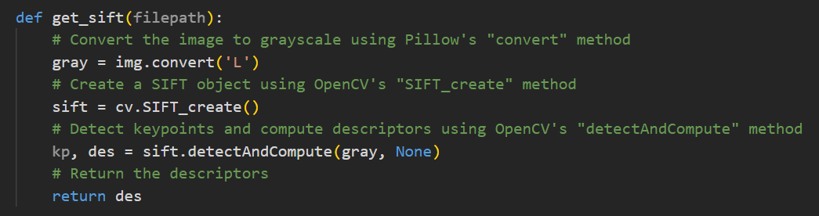
Extracting SIFT descriptors (I)
Keypoints within images have been detected using the openCV python library.
Specifically it has been firstly constructed a SIFT object (sift = cv.SIFT_create() ) and then points and descriptors have been detected and computed through the sift.detectAndCompute() method.

Slide 4
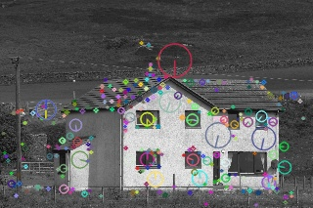
Extracting SIFT descriptors (II)
Example: Keypoints on one image from the dataset printed using
img=cv.drawKeypoints(gray,kp,img,flags=cv.DRAW_MATCHES_FLAGS_DRAW_RICH_KEYPOINTS)
cv.imwrite('sift_keypoints.jpg',img)
which draws the small circles on the locations of keypoints, with size of keypoint and its orientation.

Slide 5
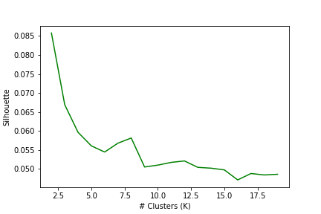
K-Means on keypoints
At this point, it has been applied K-means clustering algorithm to SIFT detectors.
Using sklearn library, the optimal number of K clusters has been detected plotting the average silhouette score for different numbers of clusters (from 2 to 20) through the Silhouette Elbow graph, resulting as best value K =6.
kmeans = KMeans(n_clusters=6)
kmeans.fit(data)
cluster_labels = kmeans.labels_

Slide 6
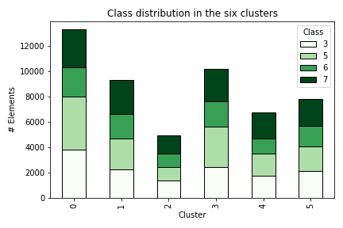
Exploring clusters
Clusters have been explored creating a df which contains the number of elements for each class and cluster:
count_df = descriptor_df.groupby(['Cluster', 'class'])['class'].count().unstack().fillna(0)
Each of the six obtained clusters shows a quite balanced distribution of descriptors from all four classes.

Slide 7
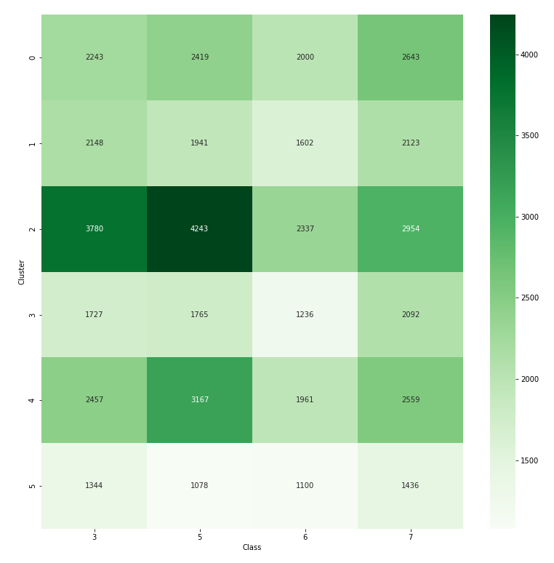
Confusion matrix
To further explore the distribution of class elements among the clusters, it has been computed a confusion matrix between the six clusters and the four classes. Also in this case, it has been used the sklearn library:
cm = confusion_matrix(descriptor_df['class'], descriptor_df['Cluster'])

Slide 8
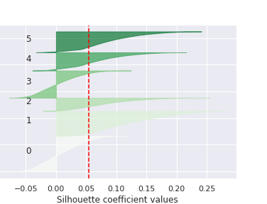
Silhouette and SSE scores
It has been calculated the mean silhouette value for each cluster obtained with K-means and created a bar chart of silhouette values for each sample.
The red vertical line in the graph shows the average silhouette value on the six samples (0.05).
Mean silhouette values for each cluster:
0.1248,
0.0874,
0.0080,
0.0675,
0.0039,
0.0802

Slide 9
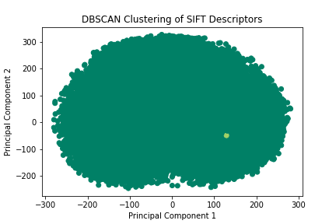
Dbscan algorithm
To explore if clustering performs better with a different kind of algorithm, data have been reduced two dimensions using PCA and clustered also with Dbscan density algorithm.
pca = PCA(n_components=2)
descriptors_reduced = pca.fit_transform(data_subset)
dbscan = DBSCAN(eps=0.5, min_samples=5)
dbscan.fit(descriptors_reduced)
Dbscan with epsilon=300 and min_samples= 5 returned 12 clusters.

Slide 10
Final considerations and conclusions
It seems to not be present a strong correlation between clusters and classes.
Average silhouette value of 0.05 shows that resulting clusters are overlapped, that the separation between clusters is not very clear and that samples could be easily confused between clusters.
Even testing another clustering algorithm different from K-means, results do not reveal significant correlations among data.

